Slide 1
Thinking Ahead: Voluntary Medical Male Circumcision Rollout With Devices
Emmanuel Njeuhmeli, MD, MPH, MBA
Senior Biomedical Prevention Advisor and
Co-Chair PEPFAR Male Circumcision Technical Working Group
Office of HIV/AIDS / Global Health Bureau,
US Agency for International Development
AIDS 2014 – Stepping Up The Pace

Slide 2
Introduction
3 conventional surgical male circumcision methods recommended by WHO including forceps guided, dorsal slit and sleeve resection
1 device pre-qualified by WHO, Prepex
Challenges of conventional surgical method
Use of local anesthesia
Pain
Limited number of health care workers
Time and resources required
Innovative method solutions
Devices?
Notes:
Since the time of the 2007 recommendation for MC for HIV prevention, the only methods for the MC procedure that have been used are three conventional surgical methods – forceps guided, dorsal slit and sleeve resection. These methods pose challenges that were raised at the time of issuance of the 2007 recommendation, and now with several years of practical implementation of services, the method challenges have been further confirmed as issues in reaching higher coverage levels. The supply side challenges include limited health care workers who can perform the conventional surgical procedure, the time and resources required; as well as demand side factors that result in inconsistency in uptake, including aspects of the procedure that are not acceptable to men.
Diverse innovative solutions to accelerate the pace of scale up by addressing various challenges have been tried and many have been successful. Regarding the MC method, work began in 2008, hoping to identify innovative adult male circumcision methods including devices that would be safer, easier and quicker than the current methods; that might facilitate more rapid healing; that might be used safely by health-care providers with less training (mid-level providers); and, that might be more cost-effective than current surgical methods.

Slide 3
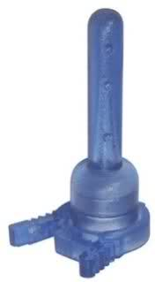
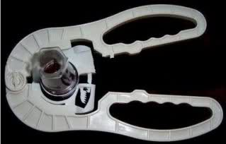
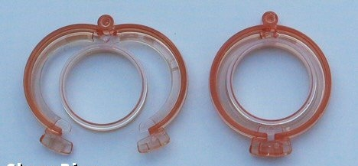
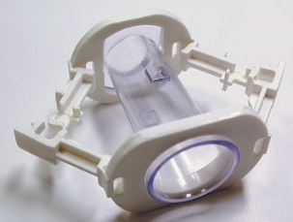
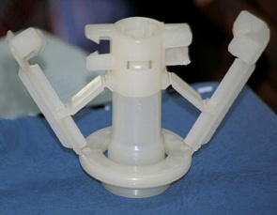
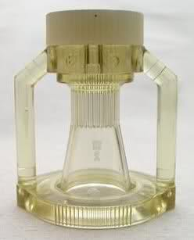
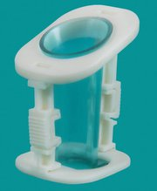
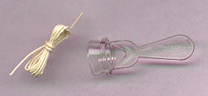
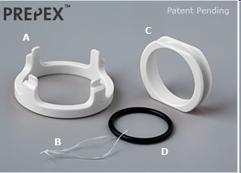
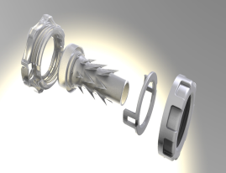
Many devices: should they be used?
others?
Notes:
A review of the device landscape a few years ago found that many devices were marketed, some shown here, but little data was available especially on use among adult males in Africa. So, the question was raised as to which one or ones of these devices could be used for adult MC for HIV prevention? Which should be used in a PH programme??
More specific questions were:
Does the device work and how well does it work in given the purpose is complete removal of the foreskin to reduce risk of HIV acqisition, how consistent are the results, how safe is a device method?
Is a device method acceptable to men… how long does the device stay on, what happens with an erection, how long is post op recovery?
Is it acceptable to providers, does it make the procedure simpler and requires less time?
Is it advantageous to public health programmes?

Slide 4
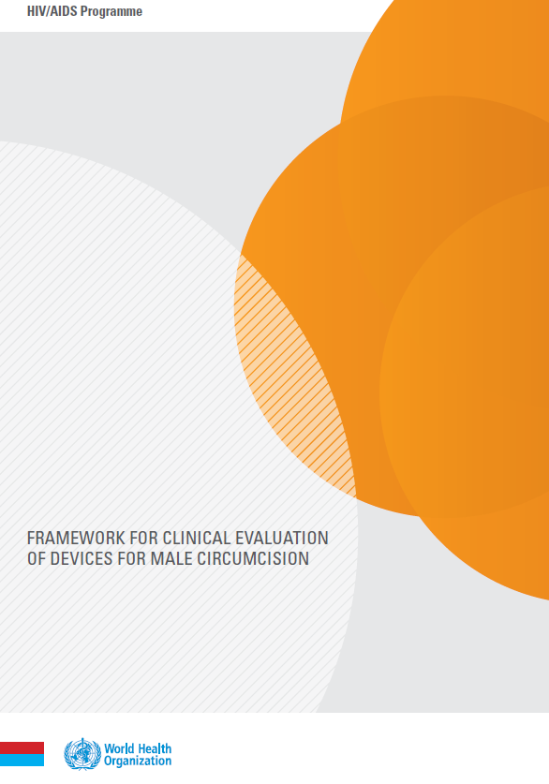
Assessing device clinical efficacy and safety
Technical Advisory Group on Innovation in Male Circumcision
advises WHO on technological innovations and reviews clinical data
Framework for clinical evaluation of devices for male circumcision
describes clinical evaluation pathways required to assess device efficacy, safety
defines key device characteristics to evaluate clinically
Notes:
WHO was asked by national programmes and partners to provide guidance to support decision making about the use of devices, and a rigorous approach was undertaken. Describe three key points or concepts to help understand the guideline and recommendation.
A Technical Advisory Group on Innovations in Male Circumcision, or the TAG, was created to advise WHO on technologies on MC and to review clinical research data.
Their inputs contributed to a Framework for clinical evaluation of devices which describes the clinical evaluation research pathways required to provide sufficient evidence of the efficacy and safety of a device; and it describes key characteristics which should be evaluated clinically, reflecting some of the questions shared a moment ago.
The Framework has formed the basis for the WHO TAG to independently evaluate clinical research findings on specific devices.

Slide 5
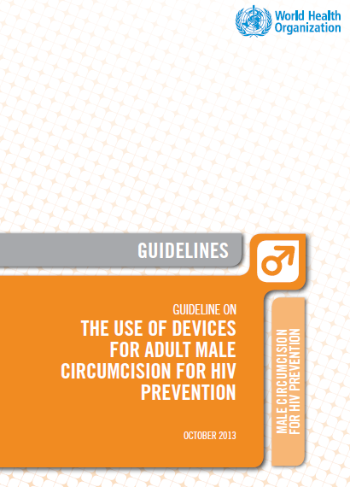
Contents
Introduction and background
Scope
Process
Evidence
Recommendation
Programmatic considerations
Notes:
This guideline will provide for the first time an evidence based recommendation regarding the use of devices as a method of male circumcision for HIV prevention. The guideline contains a brief introduction and a background with some concepts that assist in understanding the guideline and recommendation, the scope of the guideline, the process that informed its development, the evidence retrieved and used, the recommendation and lastly some programmatic considerations.

Slide 6
PrePex Device
Developed in Tel Aviv, Israel with initial clinical work conducted in Rwanda
Inner ring (C) placed between glans and foreskin
Outer O-ring (D) applied externally to foreskin using the applicator (A) and pinches foreskin in groove in inner ring
O-ring compresses foreskin causing ischemia
Necrotic foreskin removed, together with device, after 7 days
In most cases, no anaesthesia required
Circ MedTech, Tel Aviv, Israel
http://www.prepex.com/

Slide 7
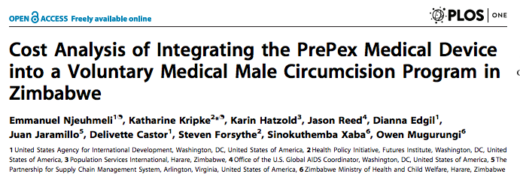
Research Questions
What is the unit cost of VMMC in Zimbabwe?
Forceps-guided surgery
Mixed (integrating PrePex into an existing surgical MC program)
What are the major cost drivers?
What impact do the following have on unit cost?
Percentage of site capacity used
Ratio of surgery vs. device-based circumcisions at a mixed site
Device cost

Slide 8
What Are the Key Cost Drivers?
 | FG-surgery only |  | Mixed site FG-surgery + PrePex
 | Cost/ circumcision | % of unit cost | Cost/ circumcision | % of unit cost
Staff | $14.90 | 27% | $17.83 | 29%
Training | $0.30 | 0.5% | $0.58 | 1.0%
Consumables | $30.36 | 54% | $27.62 | 46%
Device | $0.00 | 0% | $3.25 | 5%
Durable equipment | $0.55 | 1.0% | $1.37 | 2.3%
Supply chain management | $9.53 | 17% | $9.69 | 16%
Waste management | $0.19 | 0.3% | $0.19 | 0.3%
Total unit cost/circumcision | $55.83 |  | $60.54
Note: prices not comparable between the two site scenarios because of different staffing patterns.

Slide 9
How Does the Ratio of Device- to Surgery-based Circumcisions Affect the Cost?
% FG-surgical circumcisions | % device-based circumcisions | Unit cost
100% | 0% | $60*
95% | 5% | $60
90% | 10% | $60
80% | 20% | $61
70% | 30% | $61
60% | 40% | $62
50% | 50% | $62
40% | 60% | $62
32% | 68% | $63
The unit cost increases slightly as the percentage of device-based circumcisions increases.
Notes:
* This number is different from the unit cost at the routine surgery site because additional equipment and staff were added at the mixed study site, but there was no increase in the number of circumcisions conducted per day.

Slide 10
Site Utilization Sensitivity Analysis
Client throughput, Harare site | # circ/day | Unit cost
Minimum | 9 | $98
1st quartile | 17 | $71
Median | 26 | $61
3rd quartile | 33 | $56
Actual maximum | 58 | $50
Theoretical maximum | 120 | $45
Unit cost decreases with increased site utilization
At minimum site utilization the unit cost is more than double the unit cost of the theoretical maximum site utilization
Notes:
Mixed site

Slide 11
Device Cost Sensitivity Analysis
Device price sensitivity analysis with 68% device-based circumcisions
Device cost | Unit cost | % of unit cost
$2 | $50 | 3%
$5 | $52 | 6%
$10 | $56 | 12%
$15 | $59 | 17%
$20 | $63 | 22%

Slide 12
Conclusions
There is no significant cost difference per procedure between surgery-only programs and those that used both surgery and PrePex device
Key cost drivers are commodities including device costs, staffing, and supply chain management
Acceptability of devices as estimated by percentage of procedures performed using devices is not a significant driver of cost
Demand for male circumcision is very important—as underutilization of sites leads to significant unit costs

Slide 13
Acknowledgments
Zimbabwe MOHCW
Co-investigators of the Modeling
Dr. Katharine Kripke, HPI/Futures Institute
Dr. Emmanuel Njeuhmeli, USAID
Sinokuthemba Xaba, Zimbabwe MOHCW
Prof. Mufuta Tshimaga, University of Zimbabwe
Dr. Dianna Edgil, USAID
Dr. Steven Forsythe, HPI/Futures Institute
Dr. Delivette Castor, USAID
Juan Jaramillo, SCMS
Dr. Karin Hatzold, PSI
Dr. Jason Reed, OGAC
Dr. Anne Thomas, DoD
Dr. Renee Ridzon, Consultant BMGF
Tim Farley, Sigma 3 Services
Dr. Dino Rech, CHAPS
Robert Bailey, University of Illinois
Walter Obiero, NRHS Kenya
PSI, Jhpiego, FHI, SCMS, CHAPS
PrepPex study team Zimbabwe:
Prof. Mufuta Tshimanga, University of Zimbabwe
Dr. Tonderai Mangwiro, University of Zimbabwe
Dr. Owen Mugurungi, Zimbabwe MOHCW
Sinokuthemba Xaba, Zimbabwe MOHCW
Pessanai Chikobo, ZICHIRE

Slide 14
Thank you!

