Slide 1
Acceptability of early infant male circumcision & experiences with the AccuCirc device in Zimbabwe
Mavhu W, Ncube G, Hatzold K, Weiss HA, Mugurungi O, Larke N, Mufuka J, Samkange CA, Sherman J, Madidi N, Cowan FM, Ticklay I, Gwinji G

Slide 2
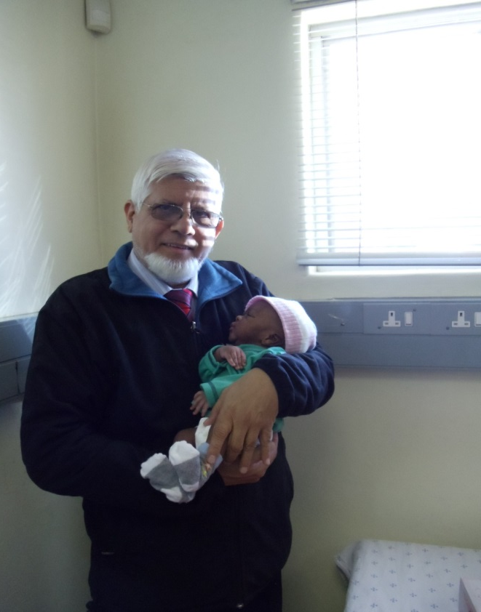
EIMC Pilot Study Steering Committee
Gerald Gwinji, MoH Zimbabwe
Getrude Ncube, MoH Zimbabwe
Owen Mugurungi, MoH Zimbabwe
Cynthia Chasokela, MoH Zimbabwe
Margaret Nyandoro , MoH Zimbabwe
Nontando Mothobi, MoH Zimbabwe
Ismail Ticklay, University of Zimbabwe
Karin Hatzold, Population Services International
Christopher Samkange, University of Zimbabwe
Frances Cowan, CeSHHAR; University College London
Webster Mavhu, CeSHHAR; University College London
Helen Weiss, London School of Hygiene & Tropical Medicine
Judith Sherman, UNICEF Zimbabwe

Slide 3
Background
Zimbabwe MoH plus partners piloting safety & acceptability of EIMC using devices
Pilot study has two main objectives:
1) To conduct a comparative trial of AccuCirc device and Mogen clamp to determine AccuCirc’s relative safety and acceptability
2) To conduct an introductory field study with AccuCirc, in order to assess intended use during programmatic implementation

Slide 4
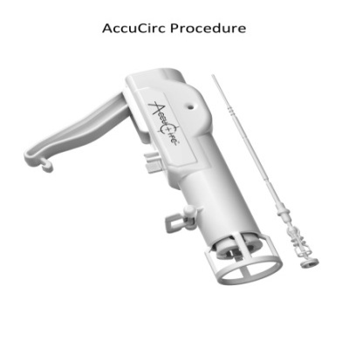
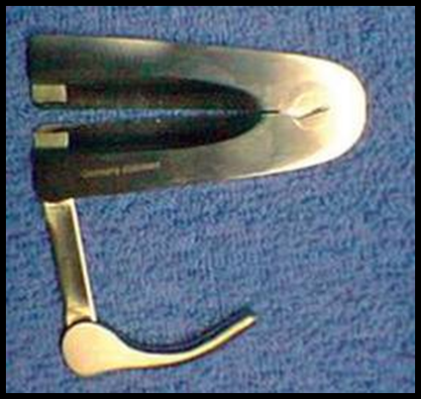
Comparative Trial Design
Randomization 2:1 to either AccuCirc device or Mogen clamp
Total sample size 150 (100 AccuCirc; 50 Mogen clamp)
Primary endpoints: EIMC safety and acceptability
Qualitative study nested within comparative trial

Slide 5
Qualitative Study Methodology
12 in-depth interviews and 4 focus group discussions (FGDs) with parents who had adopted/not adopted EIMC
95 telephone interviews with parents who had not adopted EIMC
12 in-depth interviews with health-care workers
- 4 EIMC doctors, 3 nurse-midwives & 5 clinic nurses not involved in EIMC
Notes:
This is as part of the comparative study only? Change title

Slide 6
Field Study Design
Infants circumcised through AccuCirc by nurse-midwives
Total sample size (500)
Primary endpoints:
Safety
Acceptability
Feasibility

Slide 7
Comparative Trial Results - Safety
13% (150/1,151) of all eligible male infants whose parents were offered EIMC enrolled in the trial
150 infants aged 6-54 days circumcised 9 Jan- 19 June 2013 (23 weeks)
2 moderate AEs in AccuCirc arm (95% CI 0.4-7.7%); none in Mogen clamp arm (95% CI 0.0-8.9%)

Slide 8
Parental Satisfaction with Outcome
Characteristic | AccuCirc Device (N=100) | Mogen Clamp (N=50)
Parents’ satisfaction (0-10)
<=5 | 1 (1%) | 0 (0%)
6-8 | 2 (2%) | 3 (6%)
9 | 7 (7%) | 2 (4%)
10 | 90 (90%) | 45 (90%)
Mother would recommend | 98 (98%) | 50 (100%)
Mother would have next son circumcised | 99 (99%) | 50 (100%)
Notes:
Interviewed only 25 fathers (19 AccuCirc; 6 Mogen).

Slide 9
Barriers to EIMC Uptake – Parental Perspectives
Fear of infant death
Fear of penile injury
Fear of excessive pain
Family considerations
Concerns around discarded foreskin
‘What if they overdo it and end up cutting some veins…?’ (father, FDG)
‘I don’t want to lie; I suspected that you were Satanists and that you may take the foreskin…’ (mother, IDI)

Slide 10
Qualitative Results: Providers’ Device Preference
Nearly all study clinicians preferred AccuCirc over Mogen clamp
‘…When using AccuCirc, there is less manipulation of the penis. With Mogen clamp, you manipulate the foreskin so much that the pen mark disappears… and so you won’t have a good approximation of the amount of foreskin that you should remove. As a result, you can either remove too little or too much foreskin’ (EIMC HCW, IDI).

Slide 11
Discussion
It is feasible and safe to offer EIMC using the AccuCirc device in Zimbabwe
Despite the health benefits of EIMC, actual uptake remains low
However, parental satisfaction with the procedure and the outcome is very high
Culturally appropriate EIMC demand-creation activities need to be developed and introduced to support scale-up

Slide 12
Next Steps
Conclude field study of EIMC through AccuCirc by nurse-midwives (end of July 2014)
Submit report of pilot implementation study to WHO TAG in September 2014
Develop and evaluate EIMC demand-creation intervention

Slide 13
Acknowledgements
Study staff
Research participants
Study being conducted at Edith Opperman & Mabvuku clinics
Study funded by BMGF through PSI-Zimbabwe

Slide 14
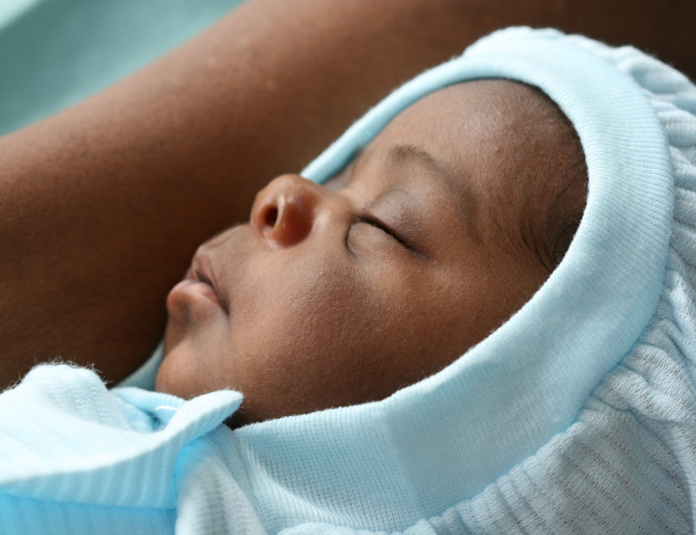
Thank You!

